Slide 1
SOLID Design Principles
Instructor: Mehroze Khan

Slide 2
SOLID Principles
Good software systems begin with clean code
The SOLID principles tell us how to arrange our functions and data structures into classes, and how those classes should be interconnected
The goal of the principles is the creation of mid-level software structures that:
Tolerate change
Are easy to understand
Are the basis of components that can be used in many software systems
The term “mid-level” refers to the fact that these principles are applied by programmers working at the module level.

Slide 3
SOLID Principles
SRP: The Single Responsibility Principle
OCP: The Open-Closed Principle
LSP: The Liskov Substitution Principle
ISP: The Interface Segregation Principle
DIP: The Dependency Inversion Principle

Slide 4
SRP-Single Responsibility Principle
The Single Responsibility Principle states that a class should do one thing and therefore it should have only a single reason to change.
A module should have a reason to change by only one actor.
A module should be responsible to one and only one actor
Only one potential change (database logic, logging logic, and so on.) in the software’s specification should be able to affect the specification of the class.

Slide 5
Why use SRP?
Many different teams can work on the same project and edit the same class for different reasons, this could lead to incompatible modules.
It makes version control easier. For example, say we have a persistence class that handles database operations, and we see a change in that file in the GitHub commits. By following the SRP, we will know that it is related to storage or database-related stuff.
Merge conflicts are another example. They appear when different teams change the same file. But if the SRP is followed, fewer conflicts will appear – files will have a single reason to change, and conflicts that do exist will be easier to resolve.

Slide 6
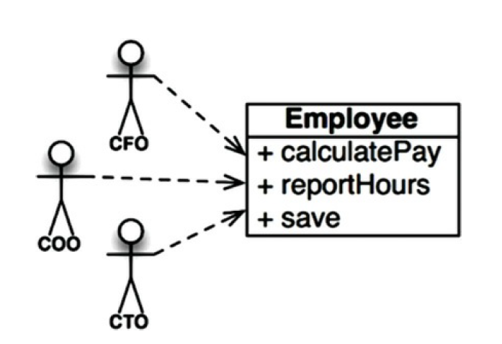
Employee Class from Payroll Application
Employee class from a payroll application has three methods: calculatePay(), reportHours(), and save()
Notes:
CFO (Chief Financial Officer)
COO (Chief Operations Officer)
CTO (Chief Technology Officer)

Slide 7
Employee Class from Payroll Application
This class violates the SRP because those three methods are responsible to three very different actors.
The calculatePay() method is specified by the accounting department, which reports to the CFO.
The reportHours() method is specified and used by the human resources department, which reports to the COO.
The save() method is specified by the database administrators (DBAs), who report to the CTO.
Notes:
CFO (Chief Financial Officer)
COO (Chief Operations Officer)
CTO (Chief Technology Officer)

Slide 8
Employee Class from Payroll Application
By putting the source code for these three methods into a single Employee class, the developers have coupled each of these actors to the others.
This coupling can cause the actions of the CFO’s team to affect something that the COO’s team depends on.

Slide 9
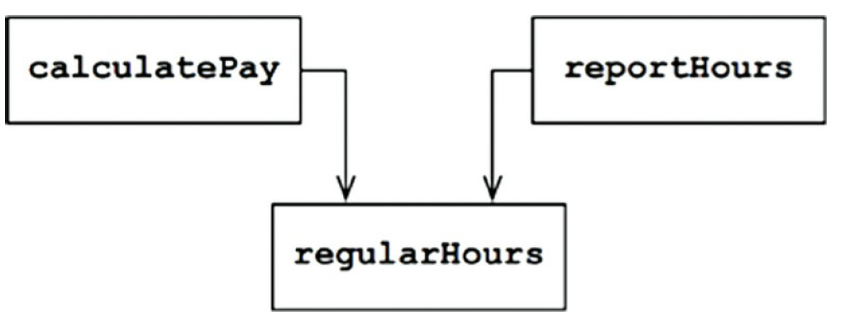
Symptom 1: Accidental Duplication
Suppose that the CFO’s team decides that the way non-overtime hours are calculated needs to be tweaked. In contrast, the COO’s team in HR does not want that tweak because they use non-overtime hours for a different purpose.
A developer is tasked to make the change and sees the convenient regularHours() function called by the calculatePay() method. Unfortunately, that developer does not notice that the function is also called by the reportHours() function.
The developer makes the required change and carefully tests it. The CFO’s team validates that the new function works as desired, and the system is deployed.
Of course, the COO’s team doesn’t know that this is happening. The HR personnel continue to use the reports generated by the reportHours() function—but now they contain incorrect numbers.

Slide 10
Symptom 2: Merges
Suppose that the CTO’s team of DBAs decides that there should be a simple schema change to the Employee table of the database.
Suppose also that the COO’s team of HR clerks decides that they need a change in the format of the hours report.
Two different developers, possibly from two different teams, check out the Employee class and begin to make changes. Unfortunately, their changes collide. The result is a merge.
In our example, the merge puts both the CTO and the COO at risk. It’s not inconceivable that the CFO could be affected as well.
Once again, the way to avoid this problem is to separate code that supports different actors.

Slide 11
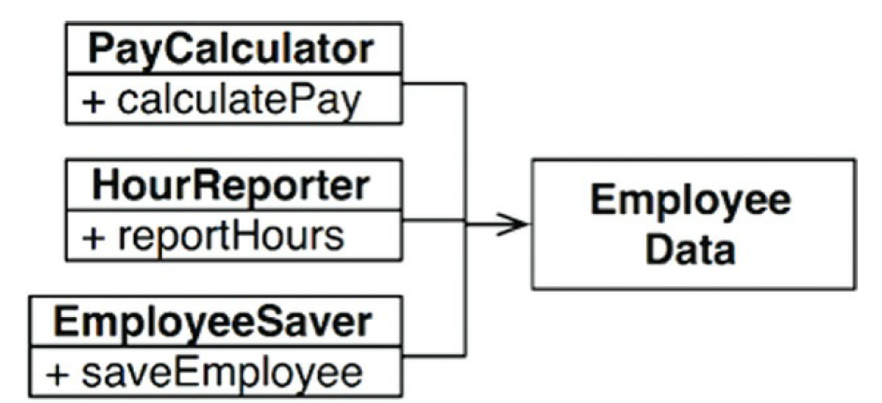
Solution
Most obvious way to solve the problem is to separate the data from the functions.
The three classes share access to EmployeeData, which is a simple data structure with no methods.
Each class holds only the source code necessary for its particular function.
The three classes are not allowed to know about each other. Thus, any accidental duplication is avoided.

Slide 12
Bookstore Invoice Program
class Book {
String name;
String authorName;
int year;
int price;
String isbn;
public Book (String name, String authorName, int year, int price, String isbn) {
this.name = name;
this.authorName = authorName;
this.year = year;
this.price = price;
this.isbn = isbn;
}
}

Slide 13
public class Invoice {
private Book book;
private int quantity;
private double discountRate;
private double taxRate;
private double total;
public Invoice(Book book, int quantity, double discountRate, double taxRate)
{
this.book = book;
this.quantity = quantity;
this.discountRate = discountRate;
this.taxRate = taxRate;
this.total = this.calculateTotal();
}
public double calculateTotal() {
double price = ((book.price - book.price * discountRate) * this.quantity);
double priceWithTaxes = price * (1 + taxRate);
return priceWithTaxes;
}
public void printInvoice() {
System.out.println(quantity + "x " + book.name + " " + book.price + "$");
System.out.println("Discount Rate: " + discountRate);
System.out.println("Tax Rate: " + taxRate);
System.out.println("Total: " + total);
}
public void saveToFile(String filename) {
// Creates a file with given name and writes the invoice
}
}

Slide 14
Invoice Class contains some fields about invoicing and 3 methods:
calculateTotal method, which calculates the total price
printInvoice method, that should print the invoice to console
saveToFile method, responsible for writing the invoice to a file
What is wrong with this class design?

Slide 15
Violations of SRP
The first violation is the printInvoice method, which contains our printing logic. The SRP states that our class should only have a single reason to change, and that reason should be a change in the invoice calculation for our class.
But in this architecture, if we wanted to change the printing format, we would need to change the class. This is why we should not have printing logic mixed with business logic in the same class.
There is another method that violates the SRP in our class: the saveToFile method. It is also an extremely common mistake to mix persistence logic with business logic.
Notes:
Persistence logic is concerned with the storage and retrieval of data from a persistent store, such as a database.
Don't just think in terms of writing to a file – it could be saving to a database, making an API call, or other stuff related to persistence.

Slide 16
How to Fix?
We can create new classes for our printing and persistence logic so we will no longer need to modify the invoice class for those purposes.

Slide 17
How to Fix?
public class InvoicePrinter {
private Invoice invoice;
public InvoicePrinter(Invoice invoice) {
this.invoice = invoice;
}
public void print() {
System.out.println(invoice.quantity + "x " + invoice.book.name + " " + invoice.book.price + " $");
System.out.println("Discount Rate: " + invoice.discountRate);
System.out.println("Tax Rate: " + invoice.taxRate);
System.out.println("Total: " + invoice.total + " $");
}
}
public class InvoicePersistence {
Invoice invoice;
public InvoicePersistence(Invoice invoice) {
this.invoice = invoice;
}
public void saveToFile(String filename) {
// Creates a file with given name and writes the invoice
}
}
Notes:
Now our class structure obeys the Single Responsibility Principle and every class is responsible for one aspect of our application.

Slide 18
OCP-Open Closed Principle
The Open-Closed Principle requires that classes should be open for extension and closed to modification.
Modification means changing the code of an existing class, and extension means adding new functionality.
We should be able to add new functionality without touching the existing code for the class.
This is because whenever we modify the existing code, we are taking the risk of creating potential bugs.
We should avoid touching the tested and reliable (mostly) production code if possible.

Slide 19
OCP-Open Closed Principle
But how are we going to add new functionality without touching the class?
It is usually done with the help of interfaces and abstract classes.

Slide 20
Let's say our boss came to us and said that they want invoices to be saved to a database so that we can search them easily.
We think okay, this is easy peasy boss, just give me a second!
We create the database, connect to it, and we add a save method to our InvoicePersistence class

Slide 21
public class InvoicePersistence {
Invoice invoice;
public InvoicePersistence(Invoice invoice) {
this.invoice = invoice;
}
public void saveToFile(String filename) {
// Creates a file with given name and writes the invoice
}
public void saveToDatabase() {
// Saves the invoice to database
}
}

Slide 22
We as the lazy developer for the bookstore, did not design the classes to be easily extendable in the future. So, to add this feature, we have modified the InvoicePersistence class.
If our class design obeyed the Open-Closed principle, we would not need to change this class.
So, as the lazy but clever developer for the bookstore, we see the design problem and decide to refactor the code to obey the principle.

Slide 23
How to Fix?
interface InvoicePersistence {
public void save(Invoice invoice);
}
We change the type of InvoicePersistence to Interface and add a save method. Each persistence class will implement this save method.

Slide 24
How to Fix?
public class DatabasePersistence implements InvoicePersistence {
@Override
public void save(Invoice invoice) {
// Save to DB
}
}

Slide 25
How to Fix?
public class FilePersistence implements InvoicePersistence {
@Override
public void save(Invoice invoice) {
// Save to file
}
}

Slide 26
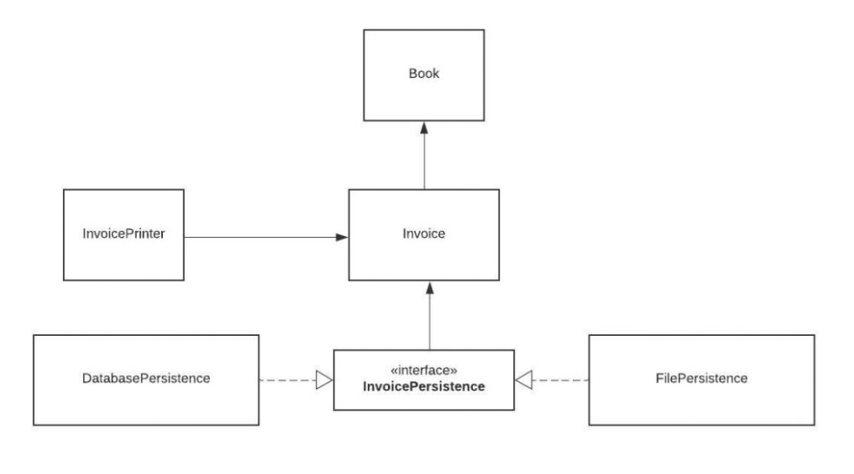
OCP-Open Closed Principle
Our class structure now looks like this:

Slide 27
OCP-Open Closed Principle
Now our persistence logic is easily extendable.
If our boss asks us to add another database and have 2 different types of databases like MySQL and MongoDB, we can easily do that.

Slide 28
Example
Imagine a program that has two instances of a square and needs a custom component to compare their area. The code would look like the following:
class Square() {
int height;
int area() { return height * height; }
}
public class Example {
public int compareArea(Square a, Square b) {
return a.area() - b.area();
}
}

Slide 29
For this specific use case, the Example class works perfectly well.
It returns zero if the two squares are the same size, a positive number if the first square is larger and a negative number if the first square is smaller.
However, a problem quickly arises when a circle is brought into the mix.

Slide 30
Extension Problem
class Circle {
int r;
int area() { return Math.PI*r*r*;}
}
class Example {
public int compareArea(Square a, Square b) {
return a.area() - b.area();
}
public int compareArea(Circle x, Circle y) {
return x.area() - y.area();
}
}

Slide 31
You can easily imagine the Example class growing larger and larger as more shapes are introduced into the problem domain.
The addition of an interface to our example helps to overcome the violation of the open-closed principle.
An interface allows for infinite future extensions with no need to ever edit the class again.
To fix this example, we first create an interface that both the circle and the square implement

Slide 32
interface Shape {
int area();
}
class Circle implements Shape {
int r;
int area() { return Math.PI*r*r*;}
}
class Square() implements Shape {
int height;
int area() { return height * height; }
}

Slide 33
We then create a new class named OpenClosedExample which has a single compareArea method that uses the Shape interface as arguments:
public class OpenClosedExample {
public int compareArea(Shape a, Shape b) {
return a.area() - b.area();
}
}

Slide 34
Example
function calculatePrice(price, discount) {
if (discount == '10%') {
return price * 0.9;
} else if (discount == '20%') {
return price * 0.8;
} else if (discount == '30%') {
return price * 0.7;
} else {
throw new Error('Invalid discount');
}
}
const discountedPrice = calculatePrice(100, '10%');
console.log(`Your discounted price is ${discountedPrice}`); // The discount you get is 90

Slide 35
The code above violates the open-closed principle because you must add another if…else statement if you want to add a new discount.
To fix it, you can extract all your discounts to an object and use it in the function

Slide 36
const discounts = {
'10%': 0.9,
'20%': 0.8,
'30%': 0.7,
};
function calculatePrice(price, discountType) {
const discount = discounts[discountType];
if (discount == undefined) {
throw new Error('Invalid discount');
}
return price * discount;
}
const discountedPrice = calculatePrice(100, '30%');
console.log(`Your discounted price is $${discountedPrice}`);

Slide 37
Now if you want to add new discounts, you only need to add to the discount object, not the existing function that calculates the discount.

Slide 38
References
Clean Architecture: A Craftsman's Guide to Software Structure and Design, 1st Edition, Robert C. Martin, Pearson, 2017.

